Slide 1
C2: Optimization Methods for CV
Lab 3: Image Segmentation
Group 5
Cristian Gutiérrez
Marco Cordón
Iñaki Lacunza

Slide 2
Index of the Lab
Segmentation
Binary Segmentation: Constraints
Energy Function
From Mumford-Shah to Chan-Vese
Chan-Vese
Level set
Minimization Process
Parameters
Initializations of ϕ
Results
Conclusions

Slide 3
Problem: Segmentation
The goal of the current week Lab is to separate the image into 2 regions. Hence, we are in a Binary Segmentation scenario.
Our binary segmentation mask Ω will consist of two regions A and B, where typically one will consist in the foreground and the other on the background Ω(A, B).
Moreover, we will make use of the Chan-Vese Segmentation approach, that differs from traditional edge-based segmentation method, by using an Optimization minimization problem of a function that considers both regions and well-defined contours.

Slide 4
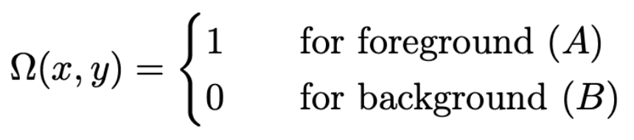
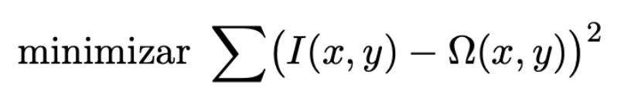
Binary Segmentation: Constraints
1st Constraint (& 5th Constraint): The segmentation result is an image.
This constraint we have just defined in the previous slide corresponds to the binary mask model of a single-channel image that assigns 0 (black pixels) to the background and 1 (white pixels) to foreground.
2nd Constraint: The segmentation image is “similar”.
We want a result that is similar to the original image, but NOT EQUAL, because that will imply that a valid solution is the original image itself.
We will do this by minimizing the square difference of the original image and our mask.

Slide 5
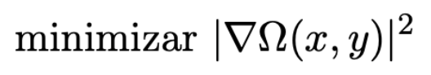


Binary Segmentation: Constraints
3rd Constraint: The segmented regions are homogeneous.
For two regions, being homogeneous mean that pixels and its neighbours of the same region have similar characteristics, in the slides this is expressed with the gradient. Therefore by enforcing a minimal “local” gradient within a region we avoid having abrupt changes within a single region:
4th Constraint: The segmented regions have smooth boundaries.
We can enforce this by minimizing the length of the boundaries, making them more consistent and avoiding boundaries with “spikes” or high variation.
Homogeneous boundaries
Not-so-homogeneous boundaries

Slide 6
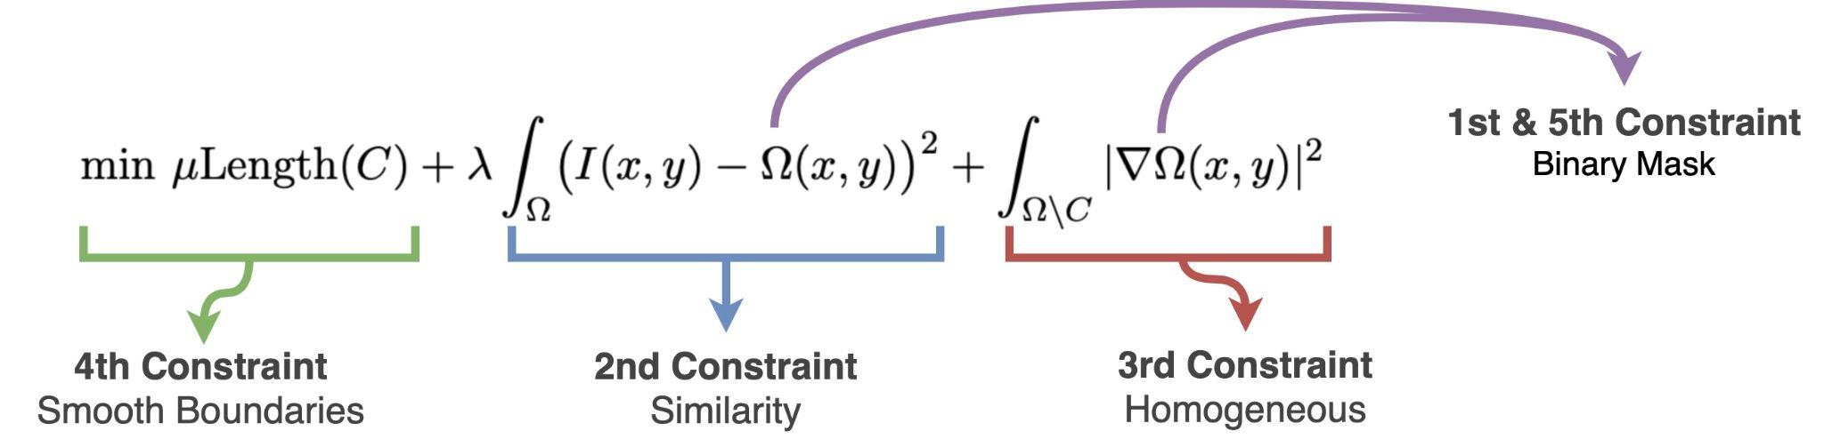
Energy Function: Putting all Together
Chan-Vese Segmentation approach is a Binary Segmentation method, that differs from traditional edge-based segmentation method, by using an Optimization minimization problem of a function that considers both regions and well-defined contours.
Now we can build a Cost function by putting all the constraints previously stated all together and we will obtain the Mumford-Shah energy function:

Slide 7
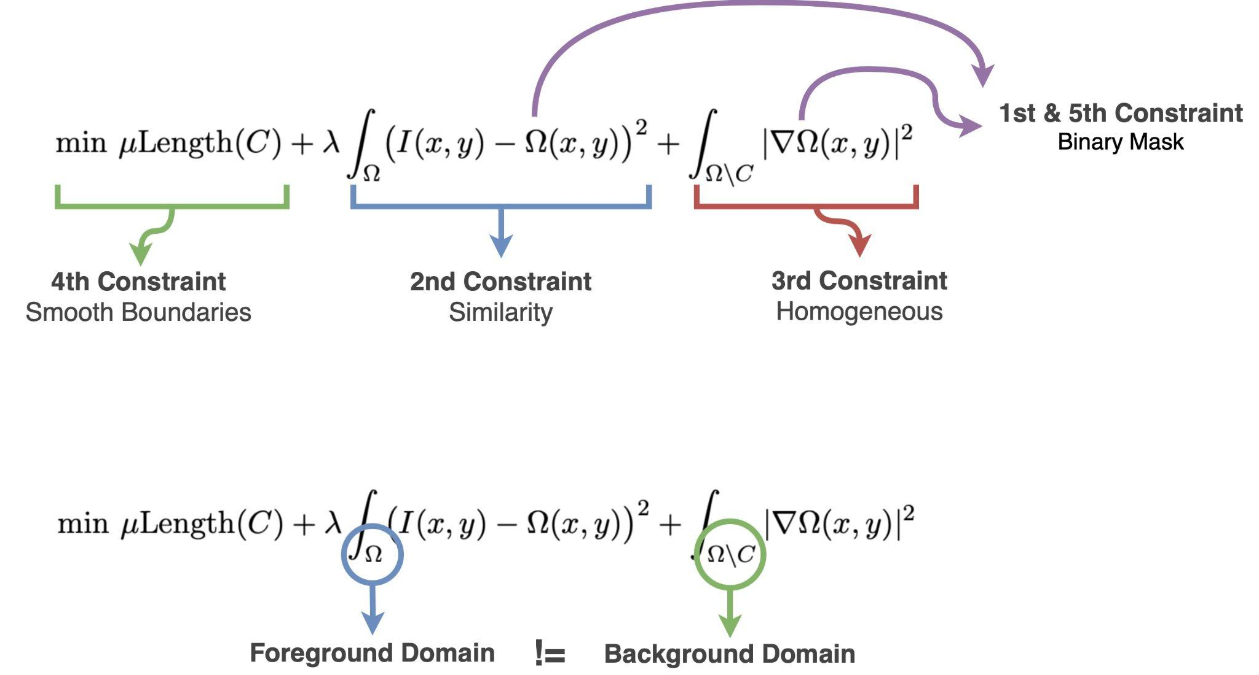
From Mumford-Shah to Chan-Vese
One main motivation for Chan-Vese is to change the domains of the Mumford-Shah to a single domain, so that we can optimize the Energy function properly.
We will define two new variables, c1 represents inside the boundaries C, and c2 represents outside the boundaries C.

Slide 8
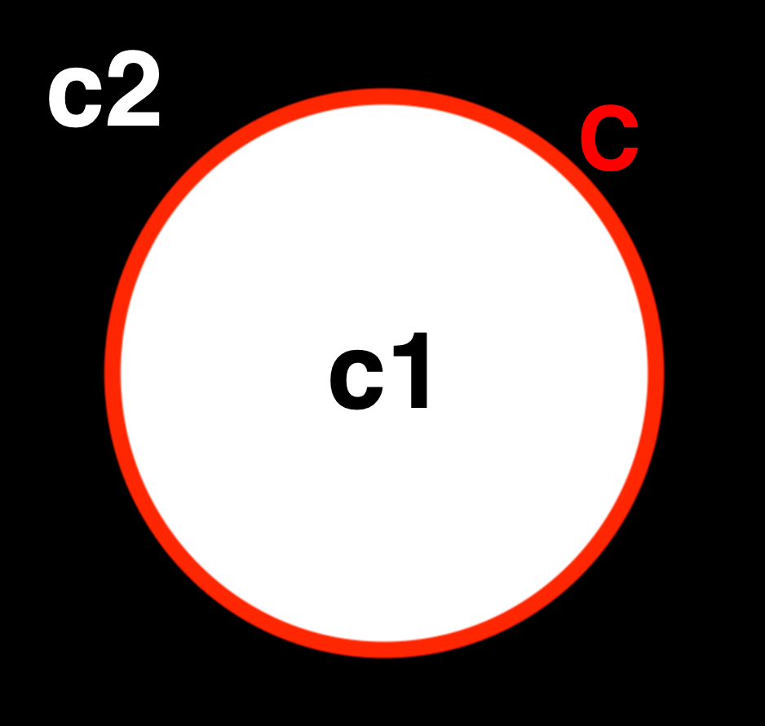
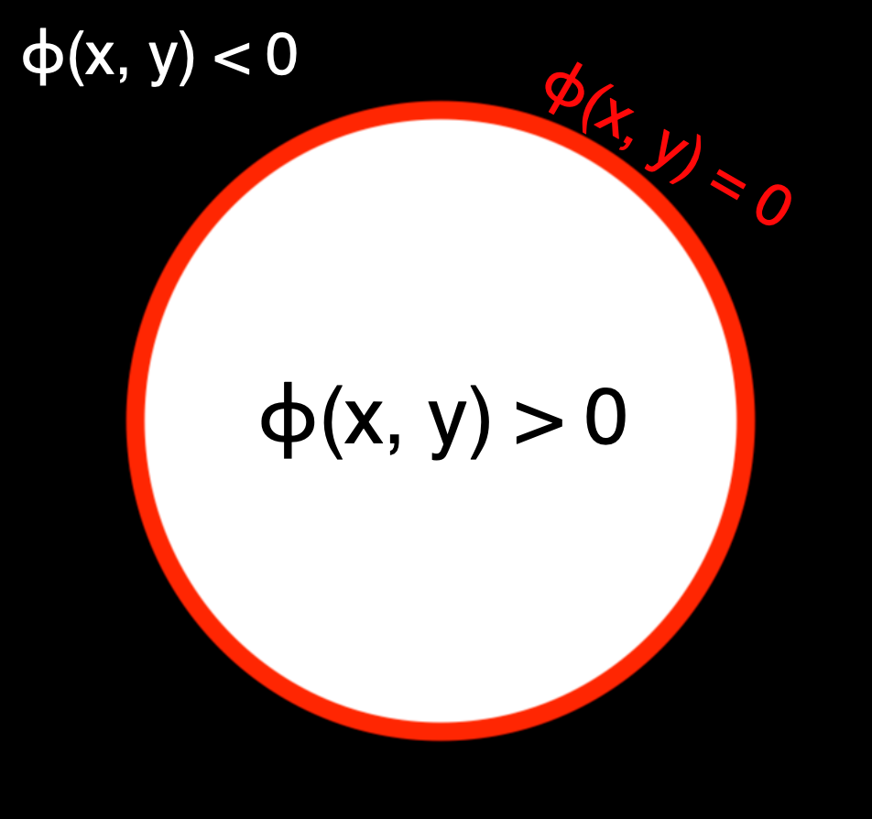
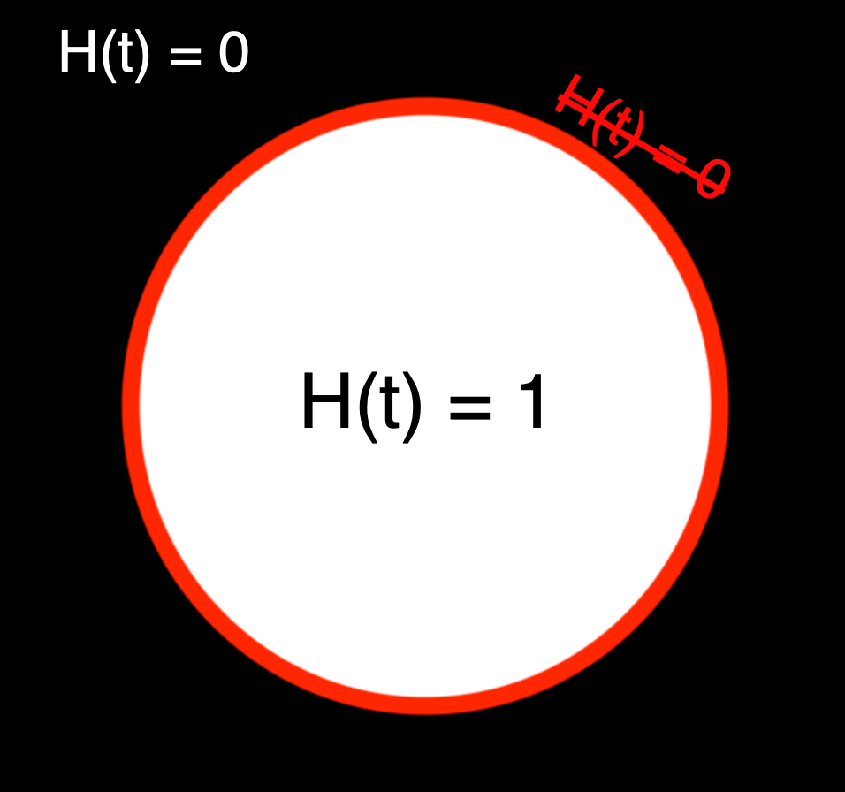
Chan-Vese: Level set
The basic model of the Chan-Vese approach is done with the C boundaries, that divide the image into c1 and c2.
In order to make to make this problem “easier” to solve numerically we will express the above regions, controlled by the Contour C as a Level Set function denoted as ϕ(x) which can be approximated with a more suitable function for computing, the Heaviside function H(t), with the drawback that now the background c2 and contours are both 0.
Basic Model
Level set ϕ(x)
H(ϕ) approximation
❌ Non differentiable
✅ Differentiable

Slide 9
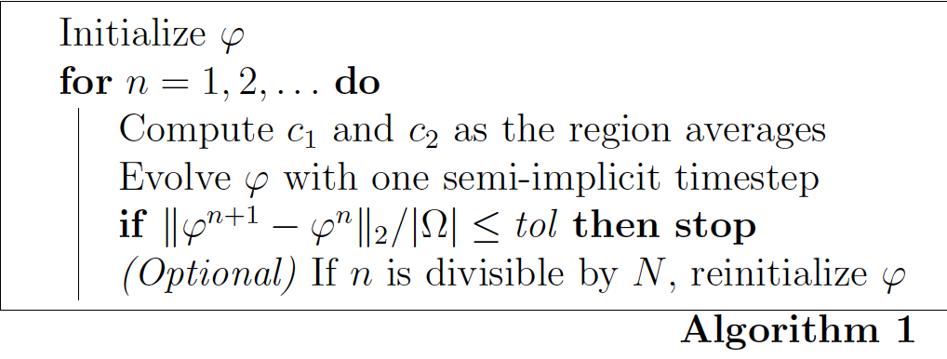
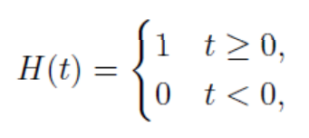
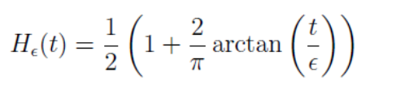
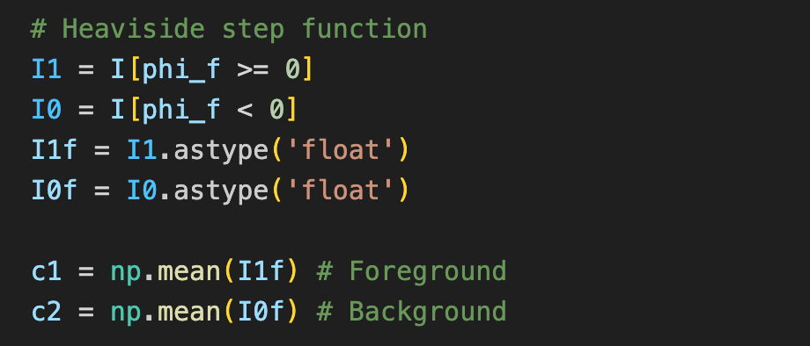
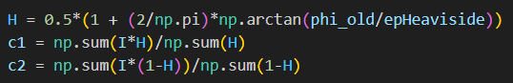
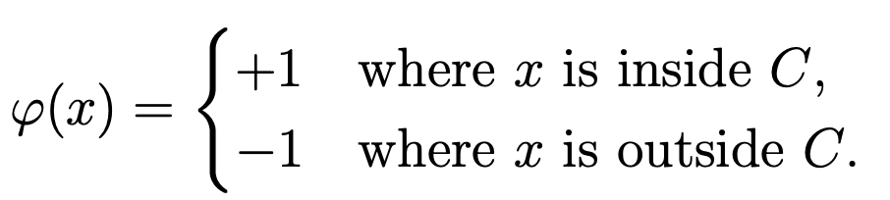
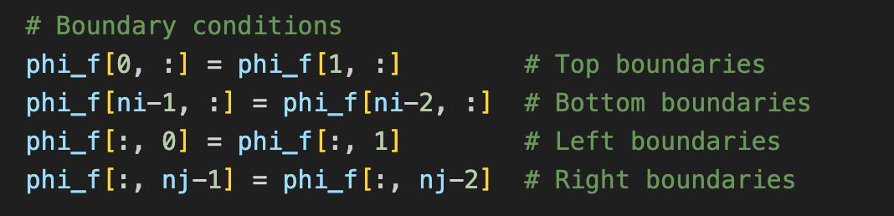
Chan-Vese: Minimization Process
1. Calculate c1 and c2 as region average
2. Boundaries for ϕ
* From slides:
* From paper:
The paper uses the ϕ(x) level set but the slides recommend the Heaviside function H(t). We have tried both options and the results almost do not differ, so we have used the paper approach.
In order for the iterative process to converge it must remain close to the boundaries to be able to obtain the correct regions estimations. Therefore we must ensure that the process takes them into account:

Slide 10
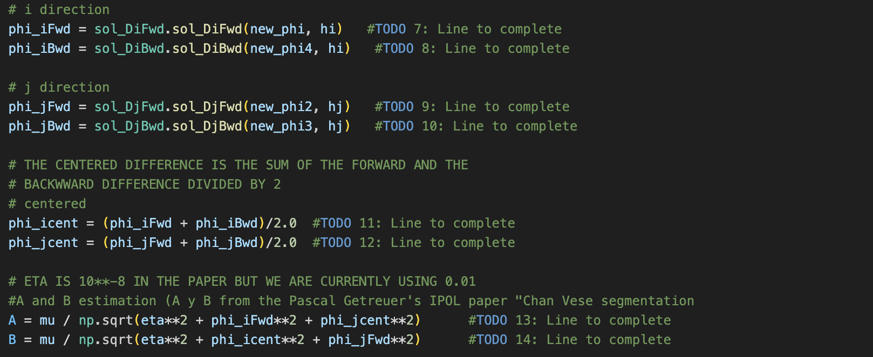
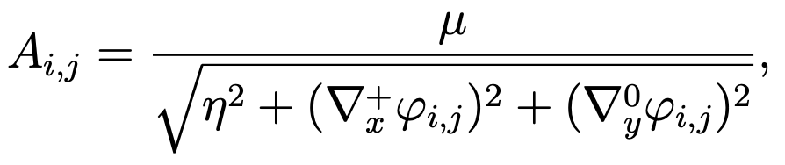
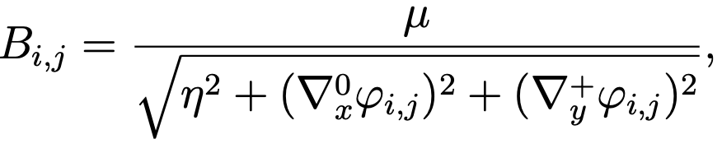
Chan-Vese: Minimization Process
3. Compute Derivatives for the A and B coefficients
By calculating the gradient in each dimension of the image, we will build the A and B coefficients known as Edge-stopping functions. Their main goal is to penalize the evolution of the level set function ϕ in terms of the gradients. Avoiding the propagation of the level set through well-defined edges.
* From paper:

Slide 11
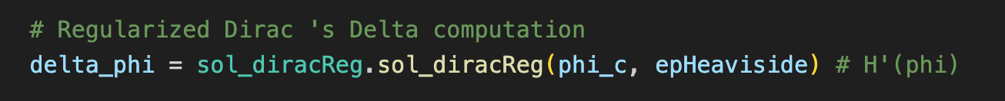
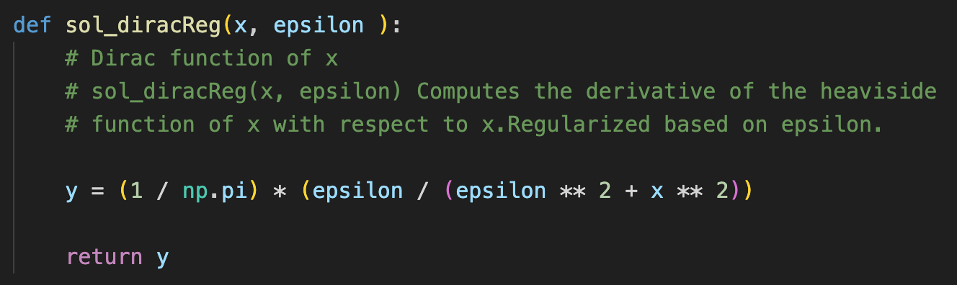
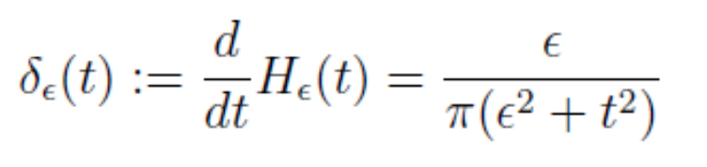
Chan-Vese: Minimization Process
4. Regularized Dirac Delta
By calculating the derivative of H(ϕ) we can now obtain our newly updated contours by using the smoothed version of the dirac delta function.
* From slides:

Slide 12
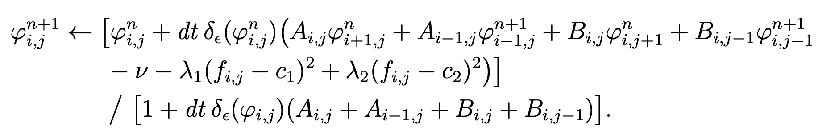
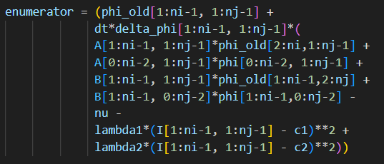
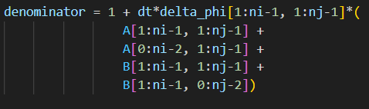
Chan-Vese: Minimization Process
5. Update step for Level Set function ϕ inner points
Finally, we will be able to update ϕ’s inner points by using numpy, thus avoiding an iterative implementation and making it all in matrix form.
* From paper:

Slide 13
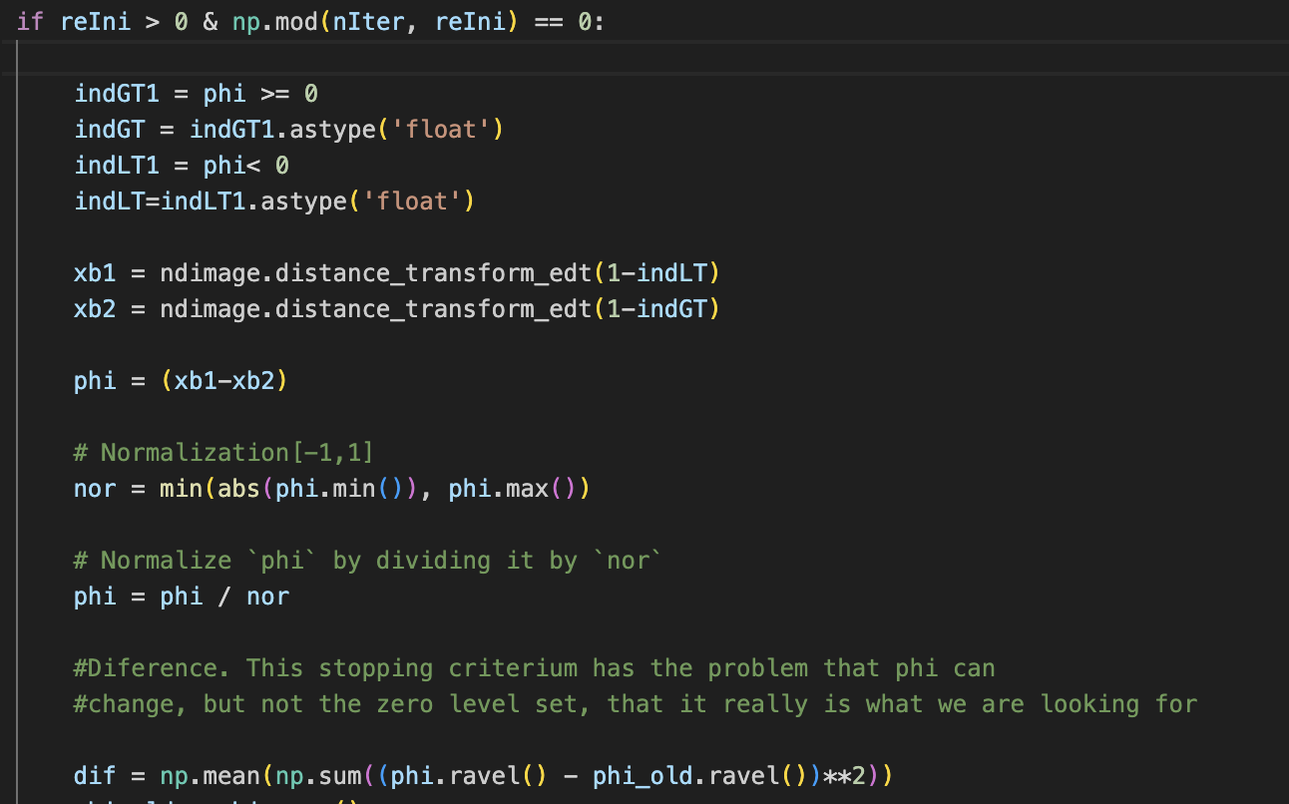
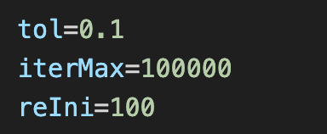
Chan-Vese: Minimization Process
6. Compute Distances
The last step is to compute the distance, between the old level set and the one we just calculated. The paper recommends using the L^2-norm, Euclidean distance, but we have used the Mean Squared Difference (MSE).
* From paper:

Slide 14
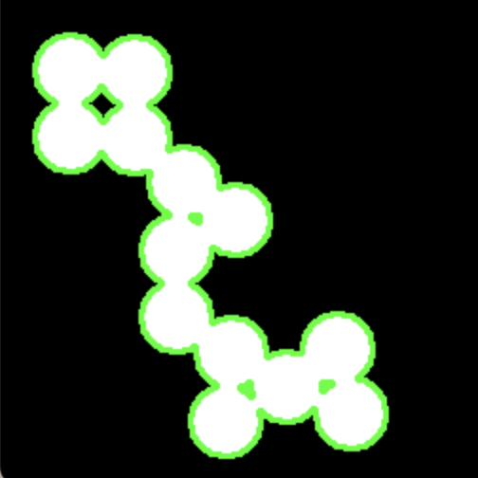

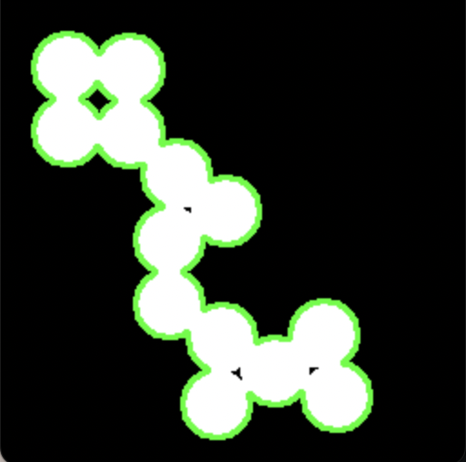
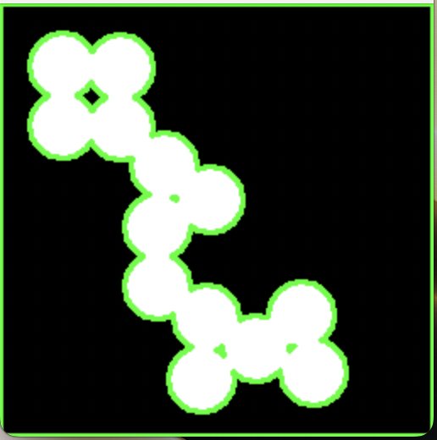
Chan-Vese: Parameters
μ = 0.01
v = 0
λ = 1
μ = 1
v = 0
λ = 1
In the Chan-Vese we have important global parameters to fine-tune:
Mu Parameter (μ): This parameter is used in the 4th constraint for smooth boundaries. It determines whether the level set will propagate in a more stable or flexible manner.
If we want to reduce noise we shall use a bigger value for μ so that we perform a more restrictive segmentation.
Nu Parameter (v): This parameter is used within the Area and controls the transition width between the two regions we want to segment.
Negative values will make the contours more narrow and abrupt, on the other hand, positive values will make them more smooth.
μ = 0.1
v = 0
λ = 1
μ = 0.1
v = – 0.3
λ = 1

Slide 15
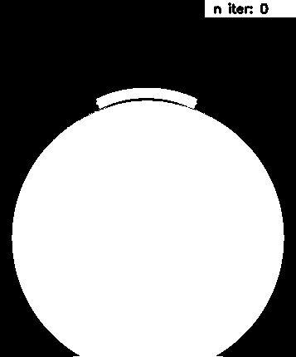
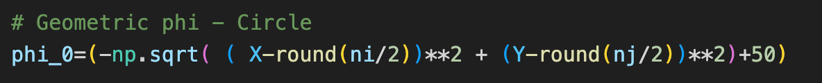
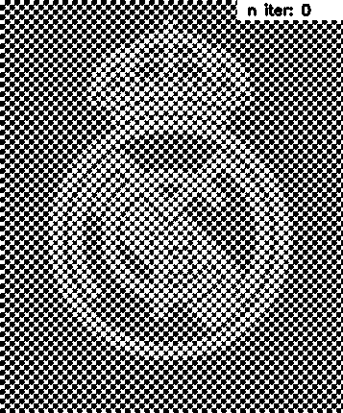
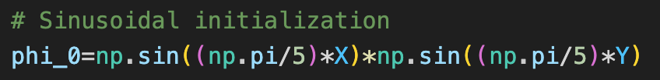
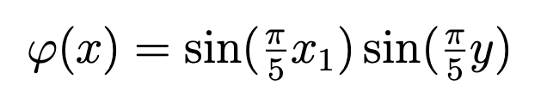
Chan-Vese: Initializations of ϕ
Geometric Initialization
Another important global change that will affect our end-results are the initialization methods of the level set function ϕ:
Geometric Initialization: This geometric level set corresponds to a centered cone.
Useful when the ROI is also a circle or is centered towards the center of the image, thus will converge faster.
Sinusoidal Initialization: This sinusoidal level set will be a periodic wave represented as a mask.
Useful if we want to capture elements that keep on repeating in a periodic way (e.g. aliasing).
Sinusoidal Initialization
* From paper:

Slide 16

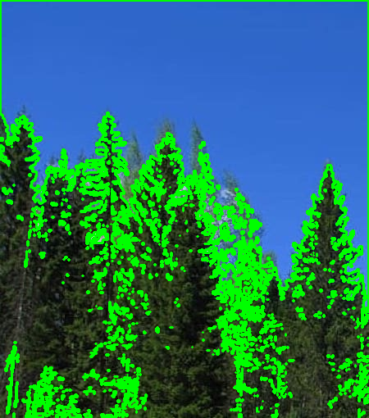
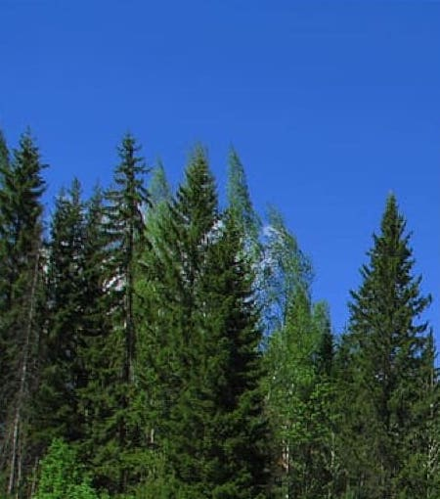
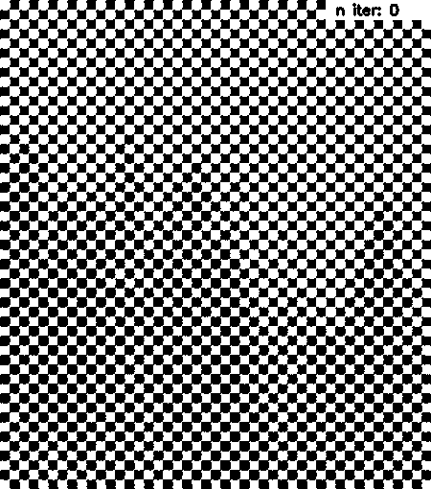
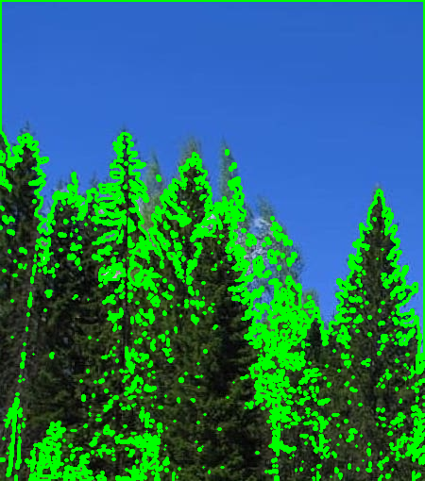
Results
Animation
Result
Original Image
Geometric initialization
Sinusoidal initialization

Slide 17

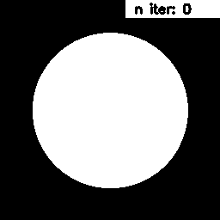

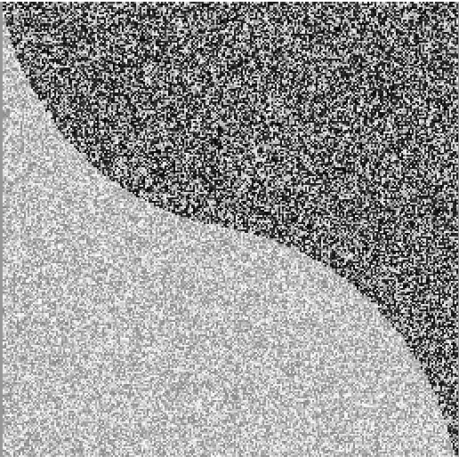
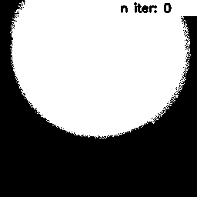
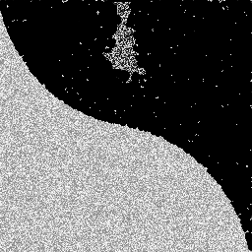
Results: Noise
Original Image
Animation
Result<<
Phantom18, one of the examples given to us, has two different images with and without noise.
By setting up a larger μ,we are able to segment the image into the two corresponding parts, however we keep getting some noise segmented.
One way to solve this would be to pre-process the images with a Gaussian filter to lower the noise before the segmentation.
Geometric initialization μ = 0.01, v = 0 , λ = 1
Original Image
Animation
Result
Geometric initialization μ = 0.12, v = 0 , λ = 1

Slide 18
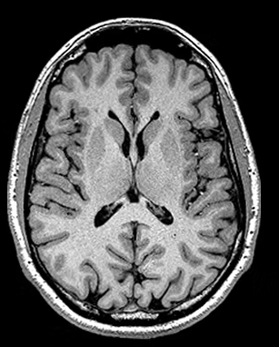
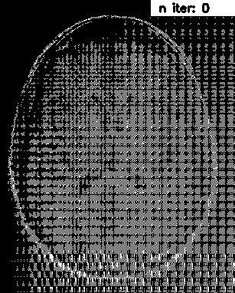
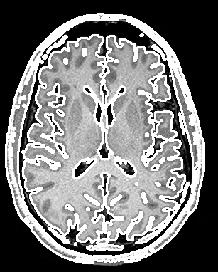

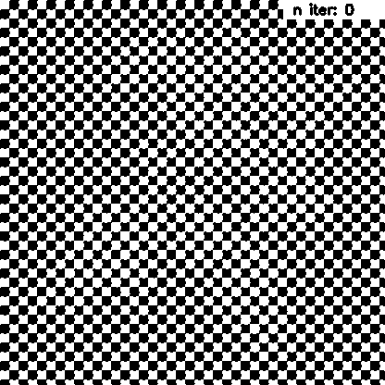
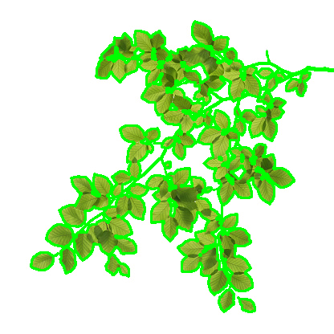
Results: Narrow Regions
Original Image
Animation
Result
In images such as an fMRI scan, like the first example, showcases how Chan-Vese can propagate through narrow regions effectively.
This is partly because of the A and B edge-stopping functions, in which we take into account the gradient for the x and y axis in the propagation which allows to go into much more detail without risking getting out of bounds.
Sinusoidal initialization
Original Image
Animation
Result
Sinusoidal initialization

Slide 19

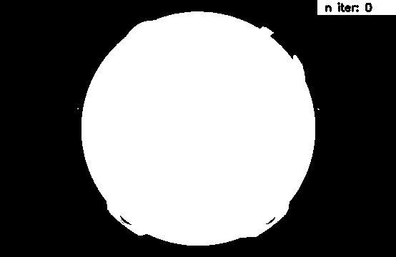

Results: Gaps
As we can see, our initialization process affects very much the end result of the segmentation.
The gap inside the ‘6’ is not segmented because the initial Geometric shape is fully covering it and there is no way to separate it once we propagate the segmentation.
Meanwhile, the ‘0’ or ‘D’ gaps are correctly segmented because in the initialization they are not fully covered.
Because of this, if it is really important to capture this gaps in the middle, to initialize using a Sinusoidal method.
Geometric initialization,

Slide 20

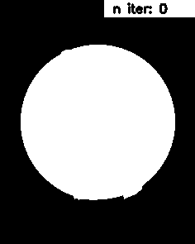


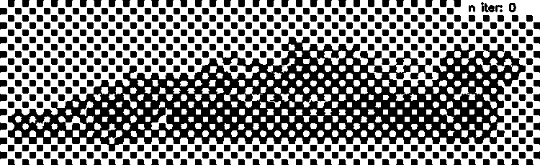

Results: Boundary complexity
Original Image
Animation
Result
It can be seen that using the Chan-Vese segmentation method complex shapes can be segmented with huge precision. The higher the used μ, the smoother the boundaries; and, the lower the used μ, the higher the accuracy of the segmentation. So, the choice of this value depends on the desired segmentation.
Geometric initialization, mu = 0.1
Original Image
Animation
Result
Sinusoidal initialization, mu = 0.001

Slide 21






Results: Region-based
Original Image
Animation
Result
Chan-Vese approach differs from traditional edge-based segmentation.
Instead of edges, it considers regions, and by computing the intensity information inside and outside the dynamic contours, is able to segment correctly some isolated parts,
e.g. the flowers that are not connected with others.
Geometric initialization
Original Image
Animation
Result
Geometric initialization

Slide 22












More results
Original Image
Animation
Result
Original Image
Animation
Result
Sinusoidal initialization
Sinusoidal initialization
Original Image
Animation
Result
Original Image
Animation
Result
Sinusoidal initialization
Sinusoidal initialization

Slide 23
Conclusions
Chan-Vese is a powerful method in Binary Segmentation, especially when we do not have strong edges, because it is a Region-based approach.
Most of the times, with the right set of parameters, we will have a fast convergence. In our case, for all of our own examples we didn’t have long computations. The ones with noise demanded more computational effort.
The initial phi selection has a lot of weight in the final result of our segmentation, especially in the details that are inside the object that we want to segmentate.
The parameter that changes the results the most is μ. This is due to the fact that the smoothness of our segmentation depends on this parameter, and, specially, when working with complex shapes, the modification of this parameter will alter the output considerably.

